Slide 1




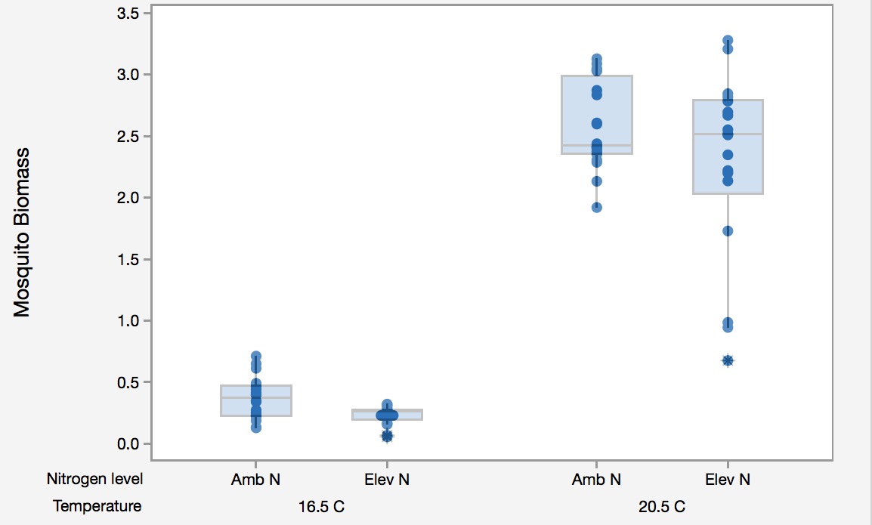
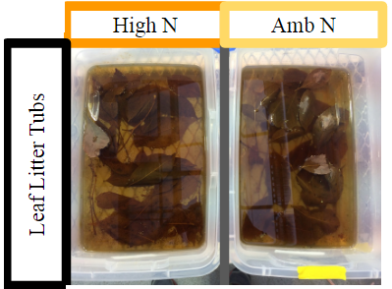
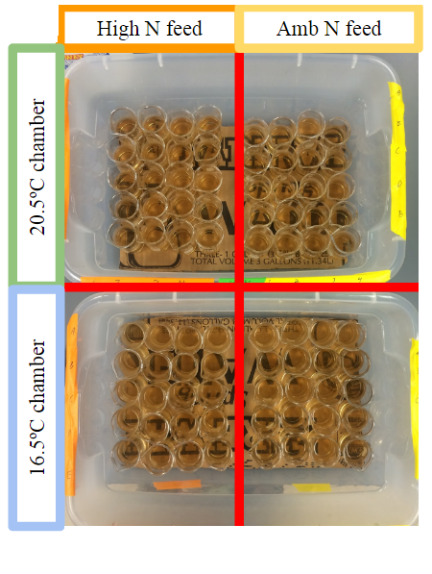
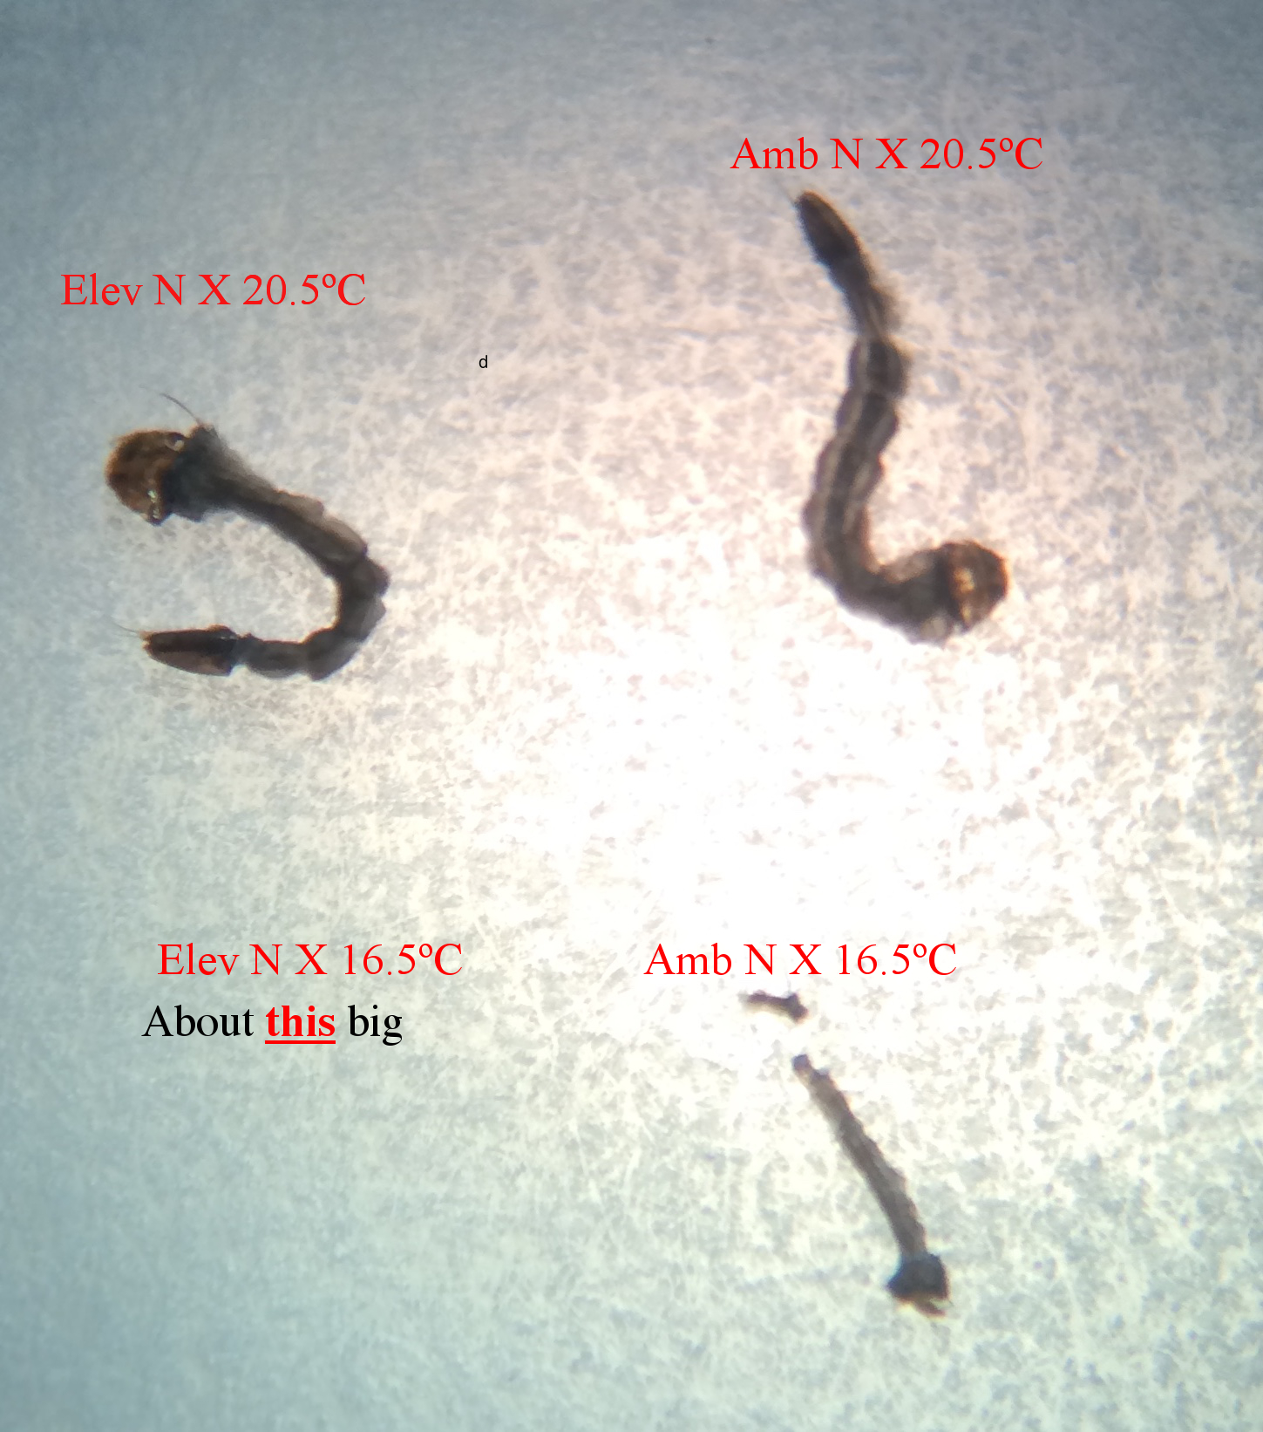
Bio 150.04
Effects of Climate
Change on Organisms
P. Jacobson
Effects of N-Enriched Leaf Litter and Decreased Temperatures on
Aedes aegypti Mosquito Larvae Development Time and Biomass
Place image of author here.
Place image of author here.
Place image of author here.
Brandon DeBella, Hye Sun Kim, Olek Yardas
ABSTRACT
Current trends of increasing global CO2 levels and average global temperatures will have significant effects on organisms. Mosquitos are an organism of interest because they are a cosmopolitan species of disease vectors which infect and kill millions of people annually (1). Mosquito larvae are cosmopolitan aquatic detritivores who feed on leaf litter and aquatic microorganisms, and are sensitive to environmental changes. We grew 80 A. aegypti larvae for two weeks to see how increased nitrogen levels and decreased temperature effected their biomass.
RESULTS
Type Text Here
DISCUSSION
INTRODUCTION
Numerous studies have explored how decreases in nitrogen availability as a result of increased carbon affect microbial communities upon which mosquitos feed. One such study conducted by Tuchman et al (2003) found that leaf detritus grown in elevated CO2 environs decreased the development rate of mosquito larvae. Another experiment by Rueda et al (1990) found that decreased temperatures increase mosquito larvae development times. To our knowledge, no experiment had yet been conducted that examined the effects of both of these variables, C:N ratio of leaf litter and temperature, on the growth rates and survivability of Aedes agypti mosquito larvae.
In examining the effects of these variables on Aedes aegypti, we hope to ascertain the overall response of the species to global warming as a whole. We hope to establish a body of literature and data from which further research into the effects of these variables can be studied.
CONCLUSIONS
Type Text Here
ACKNOWLEDGEMENTS
The authors wish to thank Professor Peter Jacobson and Ashely Millet for their help in conducting experience. Thank you to Kevin Engel for acquiring papers that we otherwise would not be able to access.
METHODS
80 Aedes aegypti larvae
Two by Two experimental design
50 mL Ammonium Nitrate added to half of leaf litter.
Two incubators, 16.5 degrees C and 21.5 degrees C
Two week period, fed once per day
REFERENCES
(1) Caraballo, Hector (May 2014). "Emergency Department Management Of
Mosquito-Borne Illness: Malaria, Dengue, And West Nile Virus". Emergency Medicine
Practice. 16 (5).
(2) Ferreira, Verónica, Gonçalves, Ana Lúcia, Gonçalves, Godbold, Douglas L., Canhoto, Cristina
(2010). Effect of increased atmospheric CO2 on the performance of an aquatic detritivore
through changes in water temperature and litter quality. Global Change Biology, 16,
3284-3296.
(3) IPCC. (2014) Climate Change 2014: Synthesis Report. Contribution of Working Groups I, II and III to the Fifth Assessment Report of the Intergovernmental Panel on Climate Change [Core Writing Team, R.K. Pachauri and L.A. Meyer (eds.)]. IPCC, p.26.
(4) Randlett DL, Zak DR, Pregitzer KS, Curtis PS (1996) Elevated atmospheric carbon dioxide and
leaf litter chemistry: Influences on microbial respiration and net nitrogen mineralization.
Soil Science Society of America Journal, 60, 1571-1577.
(5) Rueda, L. M., Patel, K. J., Axtell, R. C., Stinner, R. E.(1990). Temperature-dependent
development and survival rates of Culex quinquefasciatus and Aedes aegypti (Diptera:
Culicidae). Journal of Medical Entomology, 27 (5), 892-898.
(6) Shelton, Robert M. (1973). The effect of temperatures on development of eight mosquito
species. Mosquito News, 33, 1-12.
(7) Strand, Mac, Herms, Daniel A., Ayres, Matthew P., Kubiske, Mark E., Kaufman, Michael G., et
al. (1999). Effects of atmospheric CO2, light availability and tree species on the quality
of leaf detritus as a resource for treehole mosquitoes. Oikos, 84, 2, 277-83.
(8) Tuchman, Nancy C., Wahtera, Kirk A., Wetzel, Robert G., Russo, Nicole M., Kilbane, Grace M.
et al. (2003). Nutritional quality of leaf detritus by elevated atmospheric CO2: effects on
development of mosquito larvae. Freshwater Biology, 48, 1432-1439.
(9) Tuchman, Nancy C., Wetzel, Robert G., Rier, Steven T., Wahtera, Kirk A., and Teeri, James A.
(2002).Elevated atmospheric CO2 lowers leaf litter nutritional quality for stream
ecosystem food webs. Global Change Biology, 8, 163-170.

